Slide 1
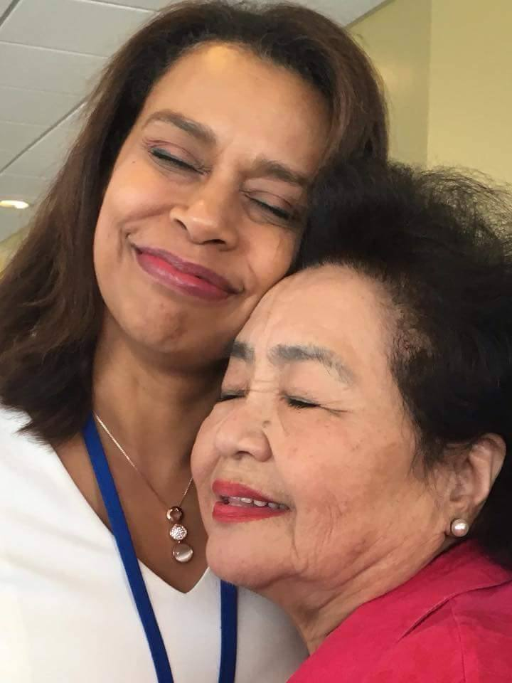
The international campaign to abolish nuclear weapons Richard Tanter
Deakin University
7 May 2018
rtanter@nautilus.org
http://nautilus.org/network/associates/richard-tanter/publications/
Notes:
<number>

Slide 2
What is to be done? Disarmament and its discontents Fundamental issues of ethics and justice remain unaddressed
The threat from NW use challenges the right to survival and human security for the world’s population
indiscriminate suffering
ecological catastrophe (nuclear winter plus climate change)
The threat of nuclear use through deterrence is an act of terror and a crime in itself
The exclusion of all populations even in stable democratic states from full knowledge of planned use by their governments, and consequent inability to make informed judgments about genuine security.
Arms control and deterrence doctrines
legitimate nuclear possession,
render nuclear next use inevitable, and
distract from the task - and hope - of nuclear abolition.
<number>

Slide 3
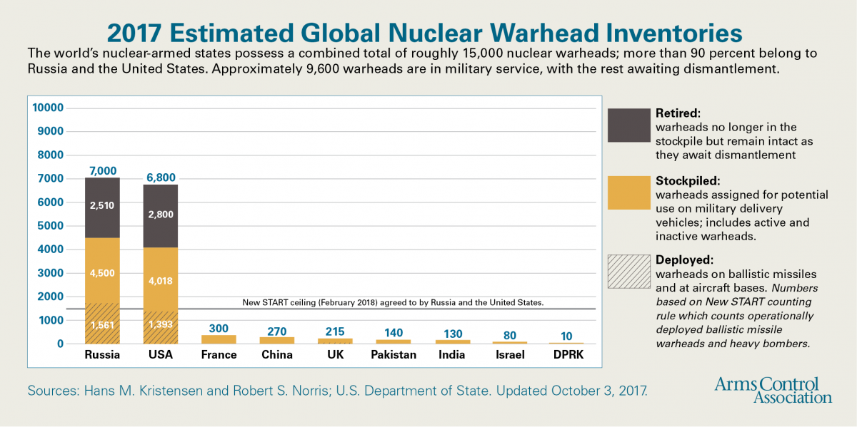
Source: Arms Control Association, at https://www.armscontrol.org/factsheets/Nuclearweaponswhohaswhat
<number>

Slide 4
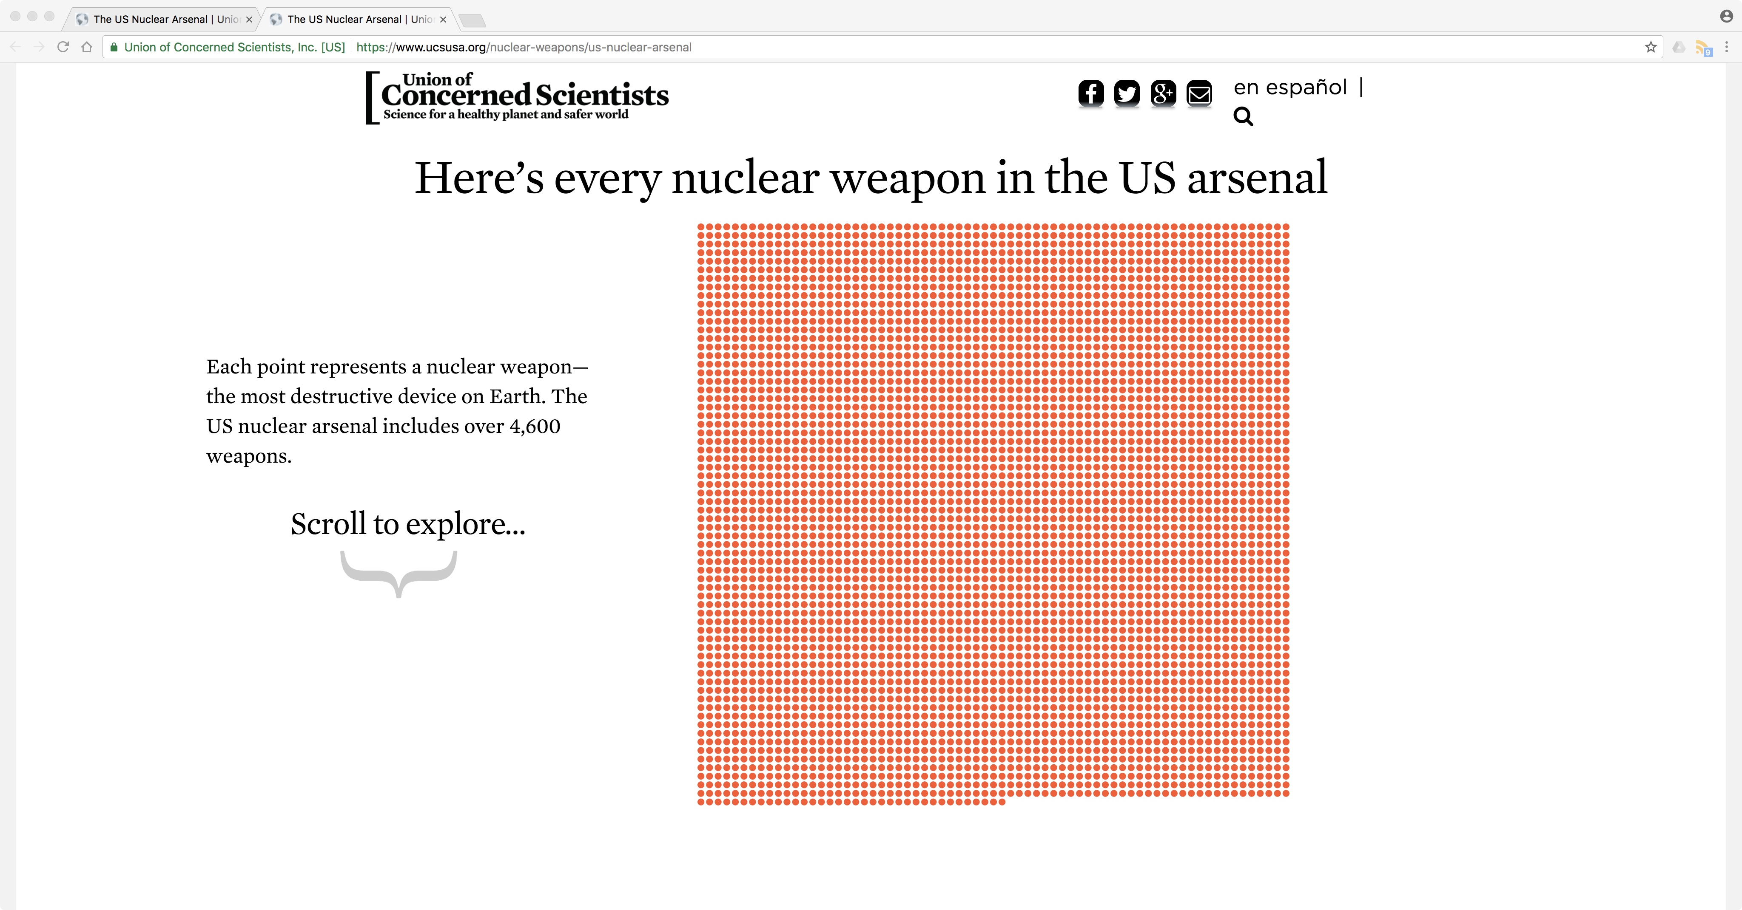
<number>

Slide 5
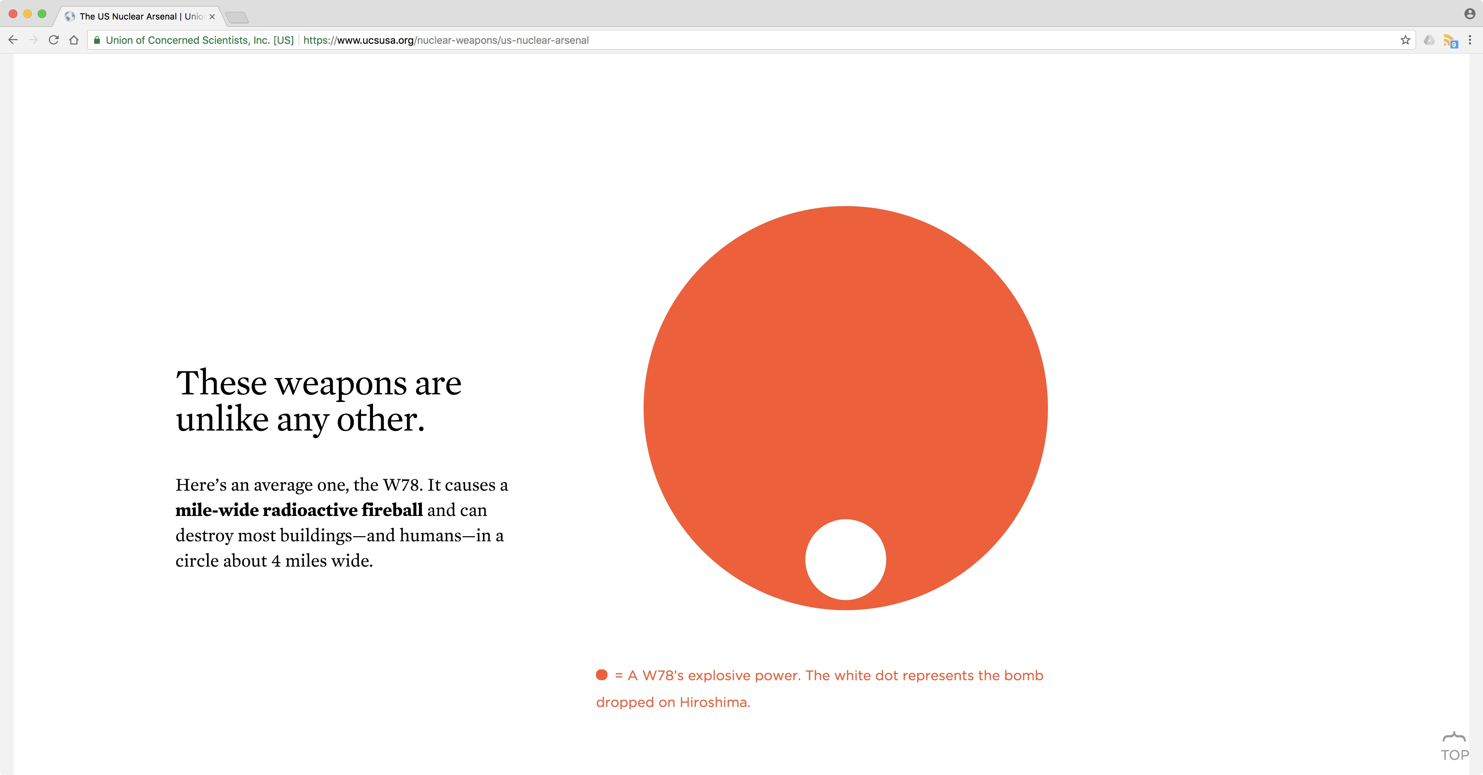
<number>

Slide 6
The UN 2017 global treaty banning nuclear weapons

Slide 7
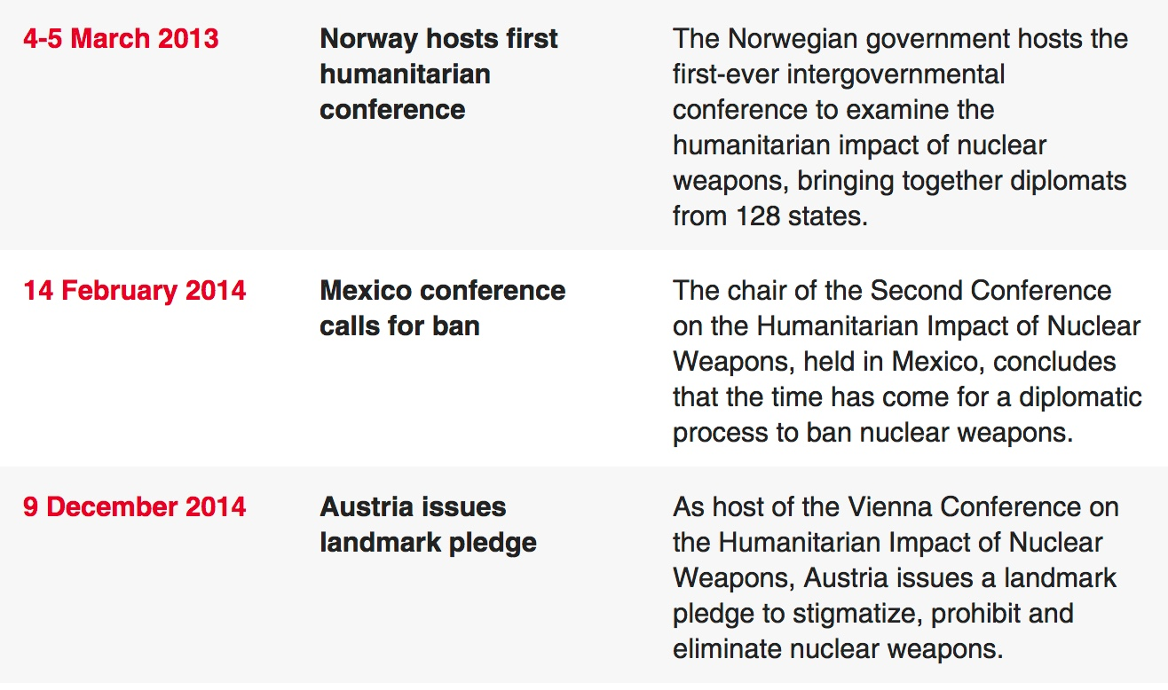
The conferences on the humanitarian effects of nuclear weapons

Slide 8
2017 Negotiations
Governmental principal movers:
Norway previous administration supported the humanitarian initiative
Austria, Brazil, Ireland, Mexico Nigeria, and South Africa moved the 2016 motion;
all Southeast Asian and Pacific Islands states (except Marshall Islands) supported to 2016 UN votes.
Non-governmental:
International Committee of the Red Cross (ICRC)
ICAN and Reaching Critical Will principal partners of the proposal mover states
Nuclear ban treaty negotiations in 2017, ICAN (includes official documents, nation al statements, FAQs, updated frequently)
Blog: Countdown to nuclear ban negotiations, ICAN

Slide 9
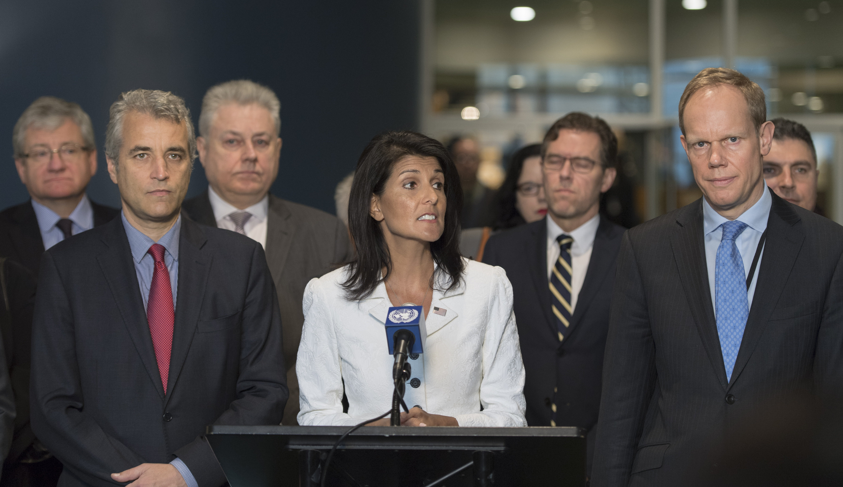
‘Nikki Haley makes ‘family values’ argument in favor of nuclear weapons’
Luke Vargas, ‘Nikki Haley makes ‘family values’ argument in favor of nuclear weapons’, Talk Media News, 27 March 2017, at http://www.talkmedianews.com/united-nations-news/2017/03/27/nikki-haley-family-values-nuclear-weapons/

Slide 10
UN Treaty on the Prohibition of Nuclear Weapons
A range of activities related to nuclear weapons are prohibited under the treaty
use,
development
production,
acquisition,
stockpiling,
retention and transfer
assistance, encouragement or inducement of anyone to engage in any of these prohibited activities.
Includes positive obligations for states parties, such as:
ensuring the rights of victims and survivors of nuclear weapons,
requiring actions to address damage to affected environments, and
providing for international cooperation and assistance to meet the obligations of the instrument.

Slide 11
Critics’ positions
Scott Sagan and Benjamin A. Valentino, 'The nuclear weapons ban treaty: opportunities lost', Bulletin of the Atomic Scientists, 16 July 2017, at https://thebulletin.org/nuclear-weapons-ban-treaty-opportunities-lost10955.
John Carlson, 'Nuclear Weapon Prohibition Treaty: A Safeguards Debacle', Trust & Verify, (VERTIC), Autumn 2017, Number 158, pp. 1-11, at http://www.vertic.org/media/assets/TV/TV158.pdf
Nick Ritchie, 'A rebuttal to critics of the nuclear weapon ban treaty', Bulletin of the Atomic Scientists, 24 July 2017, at https://thebulletin.org/commentary/rebuttal-critics-nuclear-weapon-ban-treaty10967.
Annex I, Measures proposed under the progressive approach, Report of the Open-ended Working Group taking forward multilateral nuclear disarmament negotiations, United Nations, adopted 19 August 2017, pp. 17-18
‘United States Non-Paper: “Defense Impacts of Potential United Nations General Assembly Nuclear Weapons Ban Treaty”’, Committee on Proliferation, NATO, 17 October 2016, p. 2-1.

Slide 12
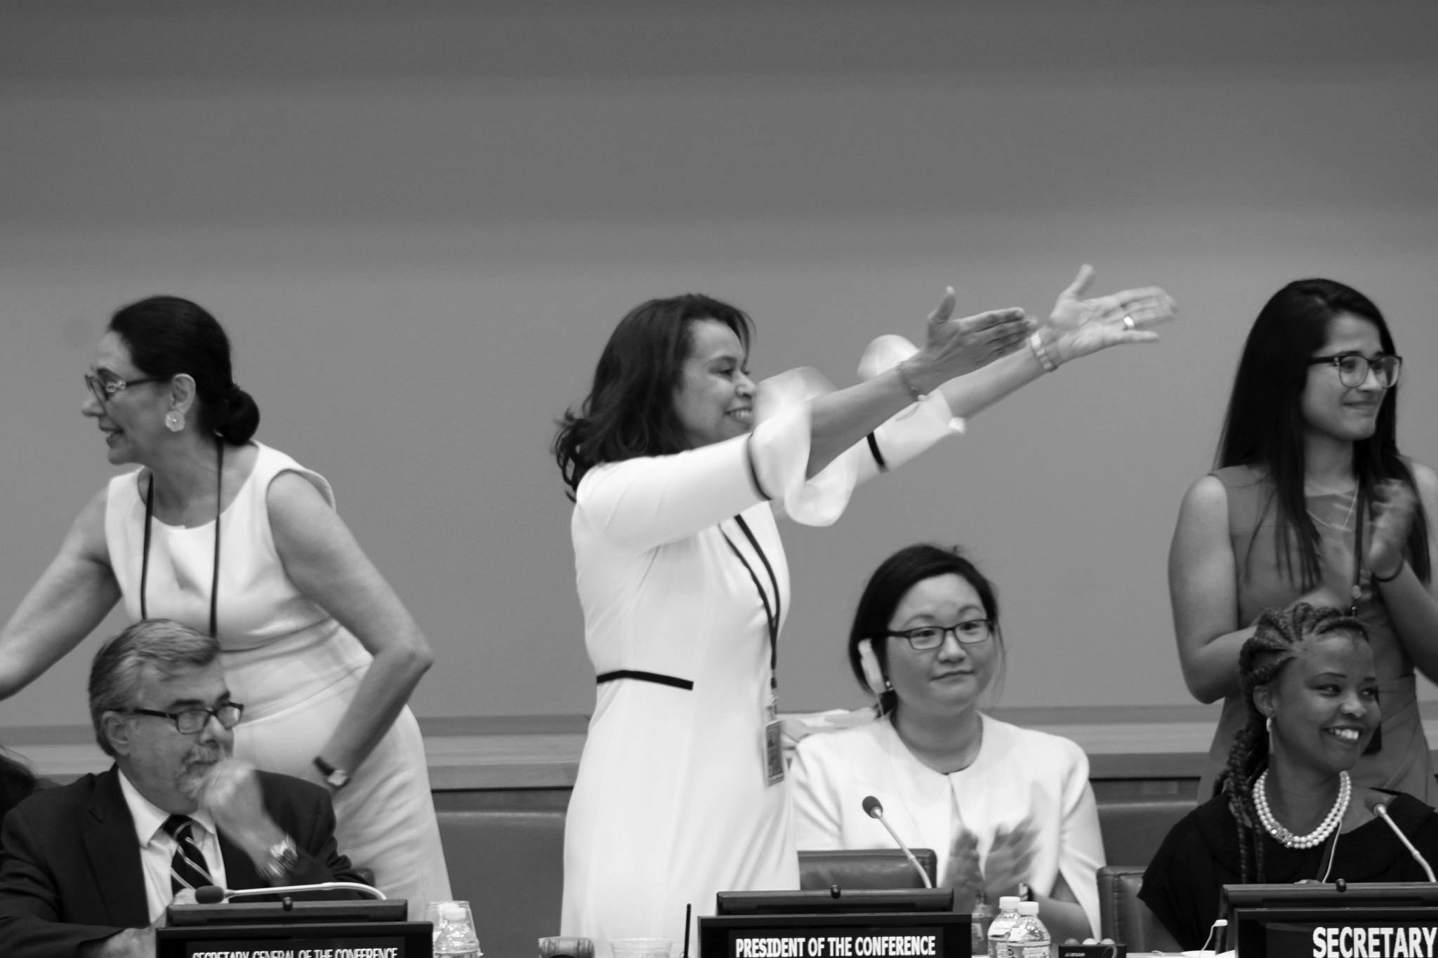
Elayne Whyte-Gomez, president of the 2017 UN negotiations

Slide 13
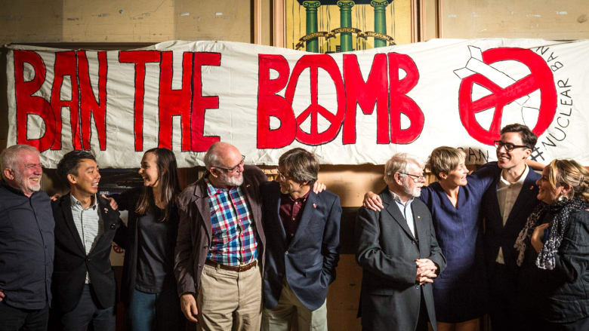
From left: Dave Sweeney, Marcus Yip, Jessica Lawson, Richard Tanter, Tilman Ruff, Fred Mendelsohn, Daisy Gardener, Tim Wright, Dimity Hawkins. Missing: the late Bill Williams, the late Malcolm Fraser, Margaret Beavis, Sue Wareham, Darul LeCornu, Gem Romuld, Nic Maclellan, John Langmore, Joe Camilleri, and Felicity Ruby
Notes:
<number>

Slide 14
Extras

